Slide 1
AI BASED PERSONALIZED LEARNING APP
Team Members:
Mirudhula K
Pavithra devi S
Pirithika P
Preethika V
Pranavi G
Team Name: Quantum learners
College Name:
Karpaga VInayaga College of Engineering and Technology

Slide 2
PROBLEM STATEMENT
Traditional e-learning platforms often follow a one-size-fits-all approach, providing the same lessons and pace for every learner regardless of their individual learning styles. This lack of personalization leads to disengagement, reduced motivation, and poor retention. Learners struggle to stay consistent and often feel overwhelmed or left behind. There is a growing need for an AI-based adaptive learning app that understands each user’s learning behavior, recommends suitable lessons and quizzes, visualizes progress through gamified elements, and provides a calm, focused environment. The solution should also ensure accessibility and inclusivity, enabling all learners to thrive at their own pace.

Slide 3
USER INTERVIEW QUESTIONS
What challenges do you face while learning from traditional e-learning apps?
Do you feel the same lessons and pace suit every learner?
How would you like an app to adapt to your learning speed and style?
Would AI-based lesson recommendations help you learn better?
How do you prefer to receive feedback — instant tips or progress reports?
What motivates you more — grades, badges, or personal goals?
Would gamified progress tracking make you more consistent?
Do you prefer calm, distraction-free learning environments?
How useful would it be if AI reminded you to revise weak topics?
Would you trust an AI system to guide your personalized learning journey?

Slide 4
GOOGLE FORM URL
GOOGLE FROM LINK :
Google Form
EXCEL SHEET:
Excel Respond

Slide 5
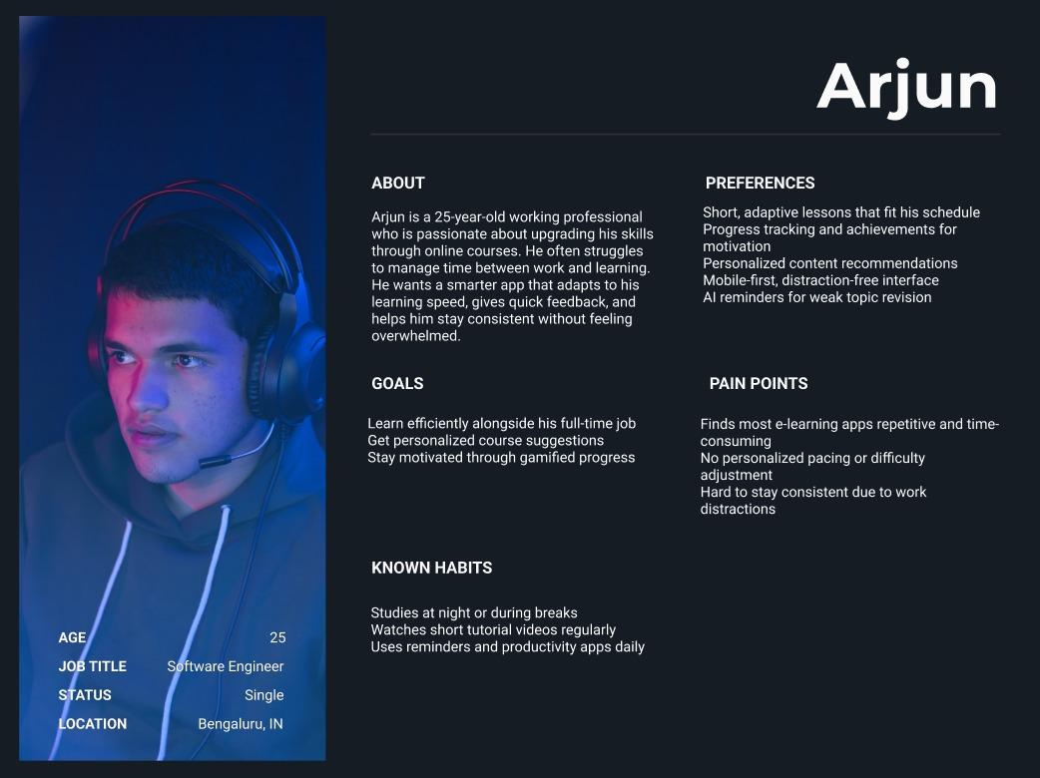
USER PERSONA

Slide 6
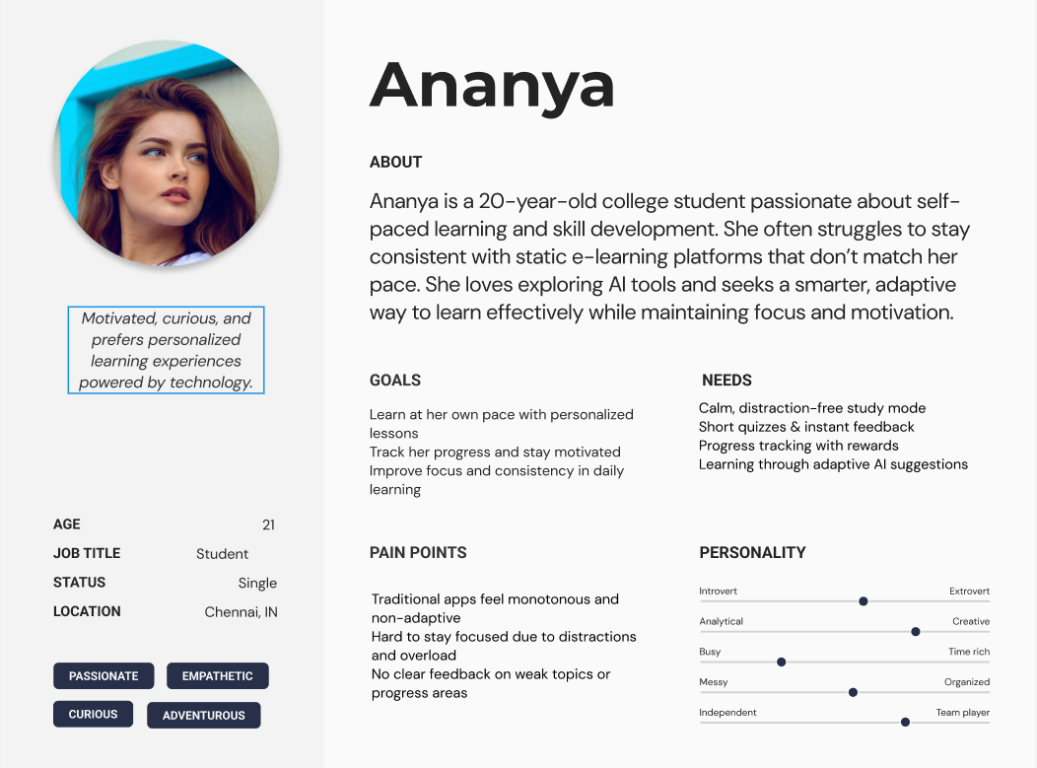
USER PERSONA

Slide 7
USER INSIGHTS
Learning Challenges:
Most students struggle with maintaining focus during long lessons, difficulty understanding complex topics, and lack of personalized learning speed. A common issue is one-size-fits-all content that doesn’t adapt to individual learners.
Effects on Learning:
Learners experience reduced motivation, slower concept grasping, and poor retention when lessons are not adapted to their pace or learning style.
Engagement Barriers:
Key barriers include monotonous lessons, lack of interactivity, and absence of timely feedback or motivation to continue learning.
Comfort with Technology:
While most students are comfortable using digital apps, some find current e-learning interfaces confusing or overwhelming, especially when progress tracking is unclear.
Personalization Concerns:
Learners worry about whether the app can truly adapt to their unique needs, such as preferred difficulty levels, subjects of interest, and learning time.
Desired Features:
Preferred features include AI-based lesson recommendations, adaptive difficulty, gamified progress tracking, instant feedback, personalized goals, and voice/text-based tutoring assistance.
Response Expectations:
Students expect immediate insights on mistakes (within seconds) and weekly summaries of their progress and skill improvement.
Situations to Use:
Users prefer using the app for exam preparation, revision sessions, concept clarification, or when needing self-paced learning outside classrooms.
Barriers to Use:
Barriers include fear of data misuse, low trust in AI recommendations, internet dependency, and lack of offline accessibility.
Improvements Expected:
Students believe the app can boost motivation, improve academic outcomes, reduce learning anxiety, and create a more inclusive, personalized educational environment.

Slide 8
USER FEEDBACK
Make the interface intuitive — learning paths should be easy to access and navigate.”
“Give us progress updates so we can track our learning goals and improvements.”
“Allow personalization — recommend courses and exercises based on our skill level and interests.”
“Include instant feedback on quizzes and assignments to help us learn from mistakes.”
“Provide reminders or study schedules to keep us consistent and motivated.”
“Enable offline access for lessons or notes when internet connectivity is poor.”
“Show a dashboard with achievements, streaks, and performance history.”
“We want the AI to adapt dynamically — challenge us when we improve, and guide us when we struggle.”
“Add community or discussion features so we can learn collaboratively.”

Slide 9
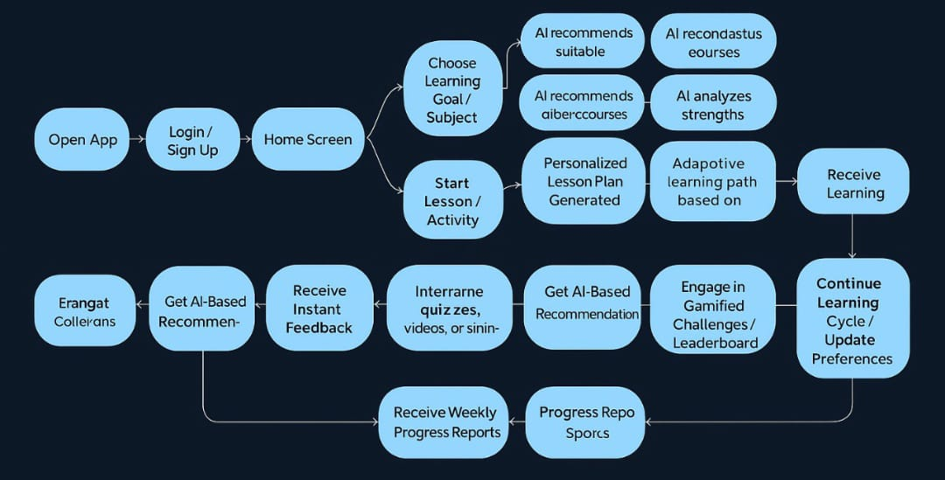
USER FLOW DIAGRAM

Slide 10
COMPETITOR ANALYSIS
Competitor | Overview | Key Features | Pros (Strengths) | Cons (Weaknesses) | Opportunities / Gaps
Khan Academy | Free global learning app for students of all ages. | Video lessons, quizzes, progress tracking. | Free, easy to use, quality content. | No live classes, limited personalization. | Add AI adaptivity and gamified learning.
Toppr | Indian app for school & exam prep. | Adaptive learning, mock tests, live doubts. | Personalized study paths, rich content. | Paid plans, cluttered UI. | Improve accessibility & focus mode.
Entri App | Regional learning & job-prep platform. | Multilingual courses, AI analytics, quizzes. | Vernacular focus, skill-based content. | Limited K-12 focus, less gamification. | Expand adaptive learning for students.

Slide 11
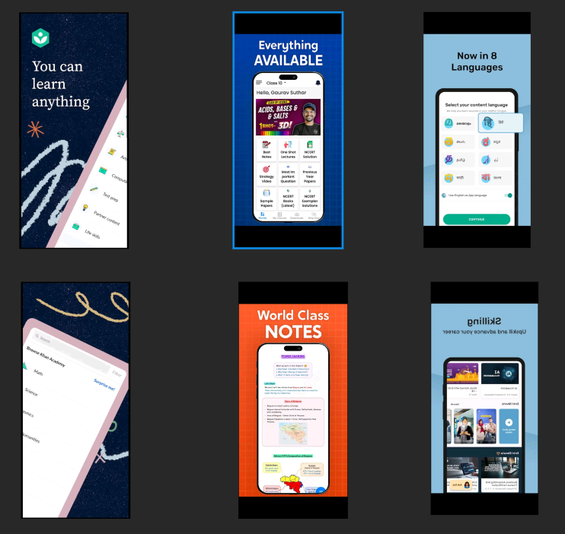
COMPETITOR ANALYSIS - COMPARISON

Slide 12
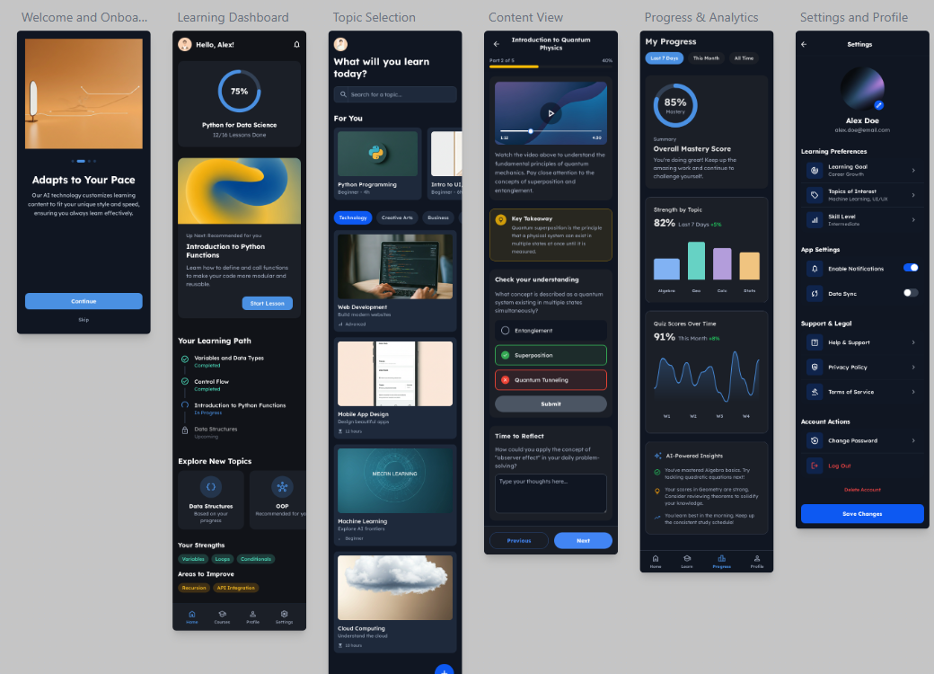
GOOGLE STITCH

Slide 13
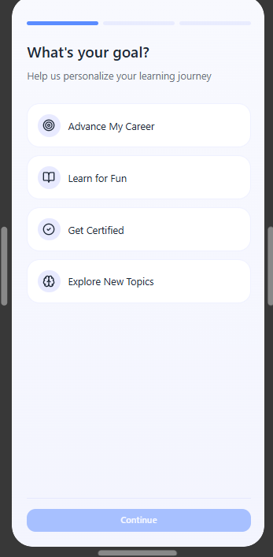
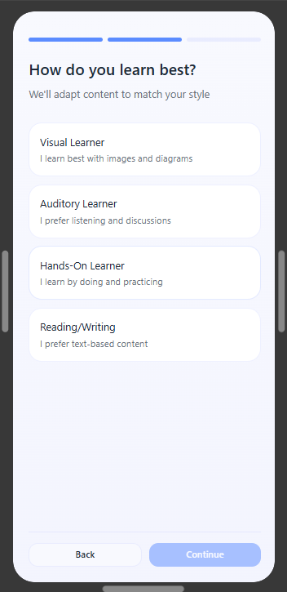
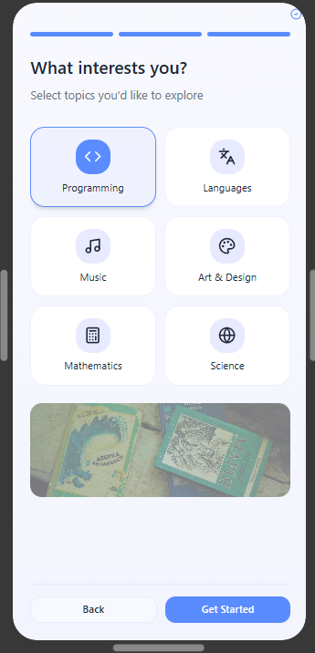
FIGMA MAKE

Slide 14
COMPETITOR ANALYSIS-COMPARISON URL
COMPARISON URL
GOOGLE STITCH PROTOTYPE URL
LINK FOR GOOGLE STITCH
FIGMA MAKE PROTOTYPE URL
LINK FOR FIGMA MAKE

